Slide 1
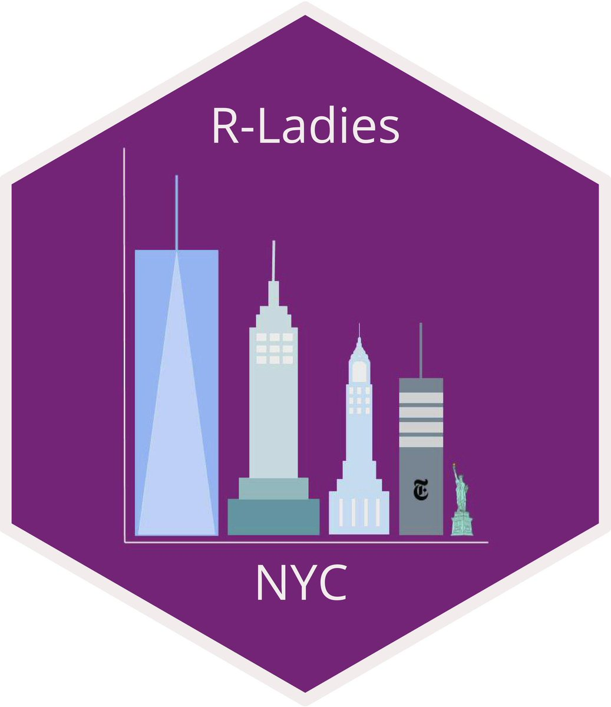
It’s Time to Shine with the timetrackR App
February 26, 2020
Jessica Lavery
Biostatistician

Slide 2
Outline
Tracking time
Time management metrics
timetrackR

Slide 3
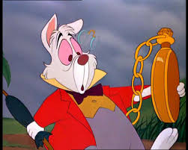
Time & the busy RLady
Often feels like there aren’t enough hours in the day
Start working on one project and loose track of time
Recall is often inaccurate

Slide 4
Why use a time tracker summary app?
It’s hard to manage your time if you don’t know how you’re spending your time
Tracking your time is only useful if you then go back and revisit it
Except for the case of time tracking for billing purposes
Useful for 1:1s and project status updates
Goal-setting and evaluating
Aid in resource allocation decisions
Notes:
Sometimes useful for effort certification reports if your organization requires them

Slide 5
Time tracking metrics
Gives a breakdown of time spent per area of project by project and investigator
If an investigator or project is taking up >50% of your time, you want to know that
If an abstract took as long as a full analysis for a manuscript, you want to know that too

Slide 6
The app

Slide 7
Screenshots

Slide 8
Information gleaned from timetrackR

Slide 9
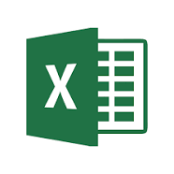
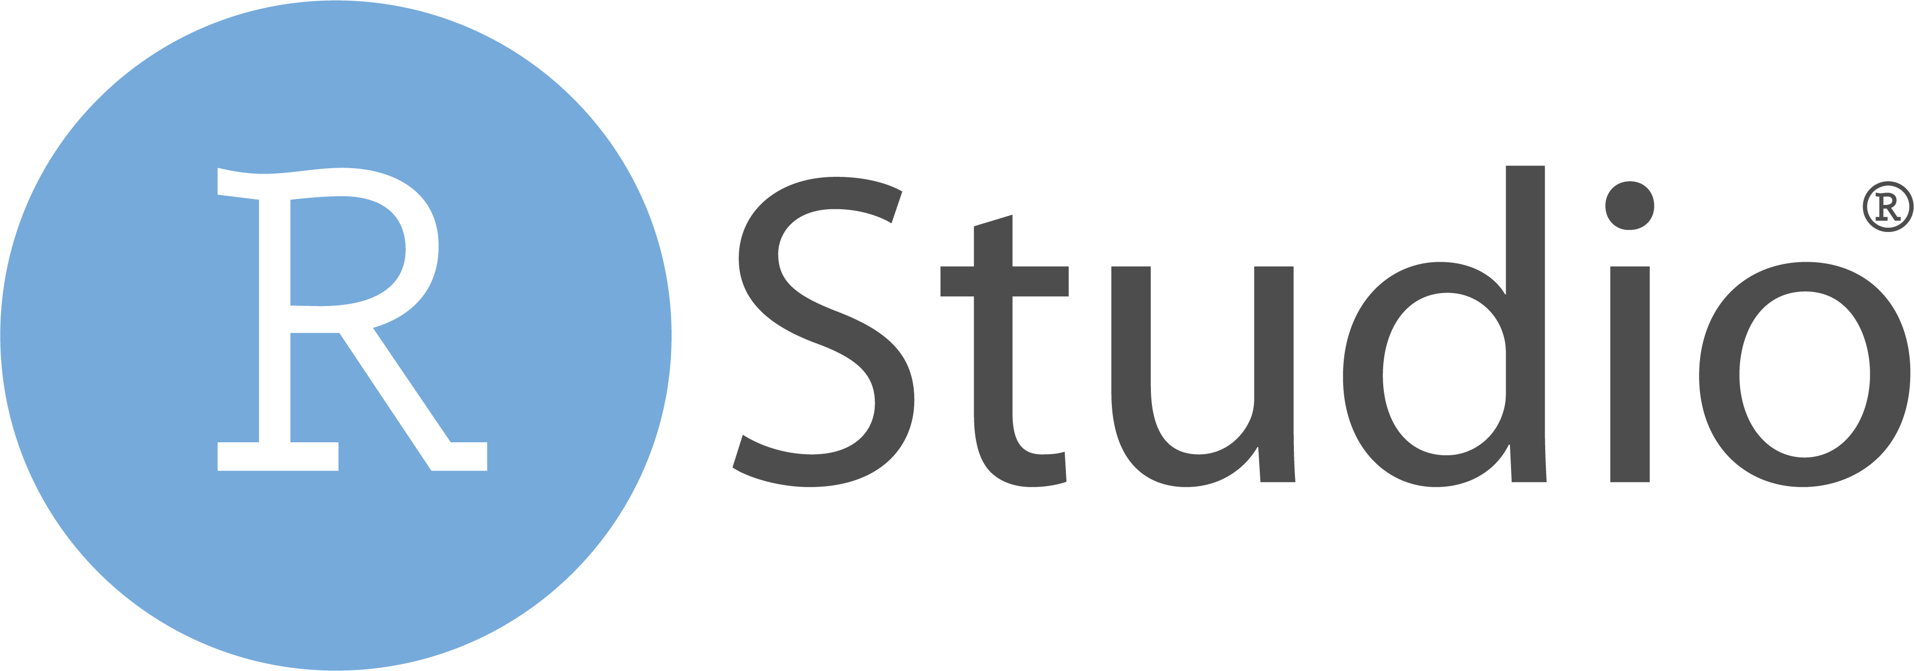
Behind the Scenes

Slide 10
Tracking time
Doesn’t have to be down to the minute
At most granular, 15 minute increments
At least granular, entire day

Slide 11
CODE

Slide 12
Caveats
The obvious: this is only useful if you track your time
Be careful about your denominators! This is a count of what you recorded
Entirely retrospective: it’s a summary of what you’ve done, doesn’t include projected time allocations

Slide 13
Adapting the app for your own use
Can track whichever components of your time you’re interested in
Can be used to summarize “current” time (active projects) or view long-term project trajectories

Slide 14
Alternative solutions: Pros & cons
Other time tracking software & reporting is available:
Toggl (free and paid versions), RescueTime, Everhour
Pros to DIY Shiny App:
Entirely customizable
Free!
Pros to other software/trackers:
Less labor intensive/maintenance not required
Can monitor apps and URLs used and identify distracters (hello Slack!)
More precise: down to the minute (if this is desired)

Slide 15
Future plans
Incorporate with Toggl app to automate a portion of the tracking
Automated time tracking + customizable reporting = best of both worlds?
Incorporate additional visualizations and/or summary measures
Suggestions?

Slide 16




Thank you!
https://github.com/jalavery/proj_mgmnt
laveryj@mskcc.org
@jessicalavs
www.JessicaLavery.com

